Slide 1

A Glance @ ASP.NET
ASP (Active Server Pages) was Microsoft’s prior server side scripting technology
Classic ASP 3.0 was the latest version
ASP.NET is next generation ASP and it is not an upgraded version of the ASP
ASP.NET is not backward compatible with ASP
ASP+ was the former name that was used for the ASP.NET
ASP.NET is a simple program that runs inside the IIS and the ASP.NET file is just a html file

Slide 2

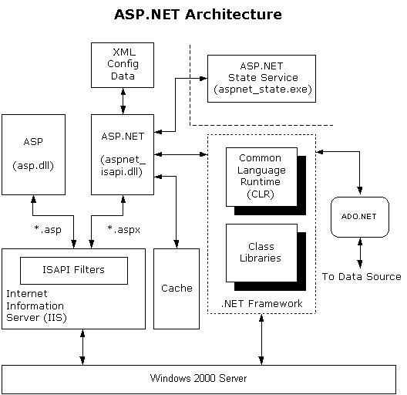
What's Inside?

Slide 3

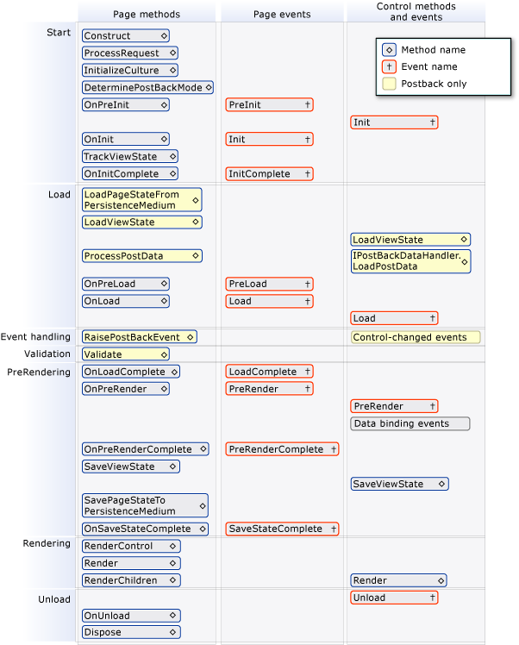
Page Life Cycle
Courtesy: MSDN

Slide 4

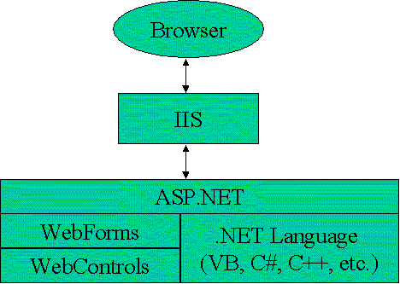
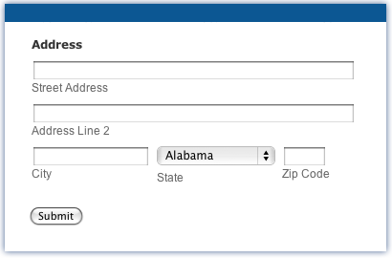
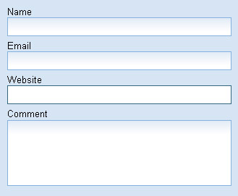
Web Forms
ASP.NET contains Web Forms and Web Controls
Web Forms are the heart and soul of ASP.NET
Web Forms are the User Interface (UI) elements that give your Web applications their look and feel
Web Forms are similar to Windows Forms in that they provide properties, methods, and events for the controls that are placed onto them
These were created to overcome certain limitations in ASP
A rich set of server-side controls that can detect the browser and send out appropriate markup language such as HTML
Event-based programming model

Slide 5

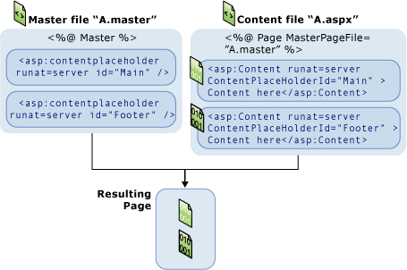
Master Pages
A master page is an ASP.NET file with the extension .master
ASP.NET master pages allow you to create a consistent layout for the pages in your application
You can create individual content pages that contain the content you want to display Achieve Clean Code

Slide 6

Themes Unleashed
A theme is a collection of property settings that allow you to define the look of pages and controls, and then apply the look consistently across pages in a Web application, across an entire Web application, or across all Web applications on a server.
Themes are made up of a set of elements: skins, cascading style sheets (CSS), images, and other resources. At a minimum, a theme will contain skins
Themes are similar to cascading style sheets in that both themes and style sheets define a set of common attributes that can be applied to any page
Themes can define many properties of a control or page, not just style properties

Slide 7

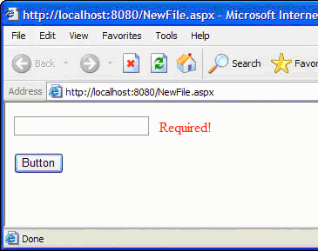
Validation
Types of validations
A validator is a control that checks one input control for a specific type of error condition and displays a description of that problem
Server Side validator
  RequiredFieldValidator, CompareValidator, RangeValidator, RegularExpressionValidator, CustomValidator, ValidationSummary
Client Side Validator
  Javascript validation

Slide 8

State Management
A new instance of the Web page class is created each time the page is posted to the server
In traditional Web programming, this would typically mean that all information associated with the page and the controls on the page would be lost with each round trip
To overcome this, ASP.NET includes state management
Types of state management
  Client Based & Server Based State Management
Various state management techniques
  View State, Control State, Hidden Fields, Cookies, Query Strings, Application State, Session State

Slide 9


Test Drive
Demo
ASP.NET Overview

Slide 10
Out of Portion
Do you Know?
ASP.NET Overview

Slide 11
Itz Time for QUIZ
A Small QUIZ
ASP.NET Overview

Slide 12
We are open for Another 5 Mins
Question & Answers
ASP.NET Overview

